Slide 1

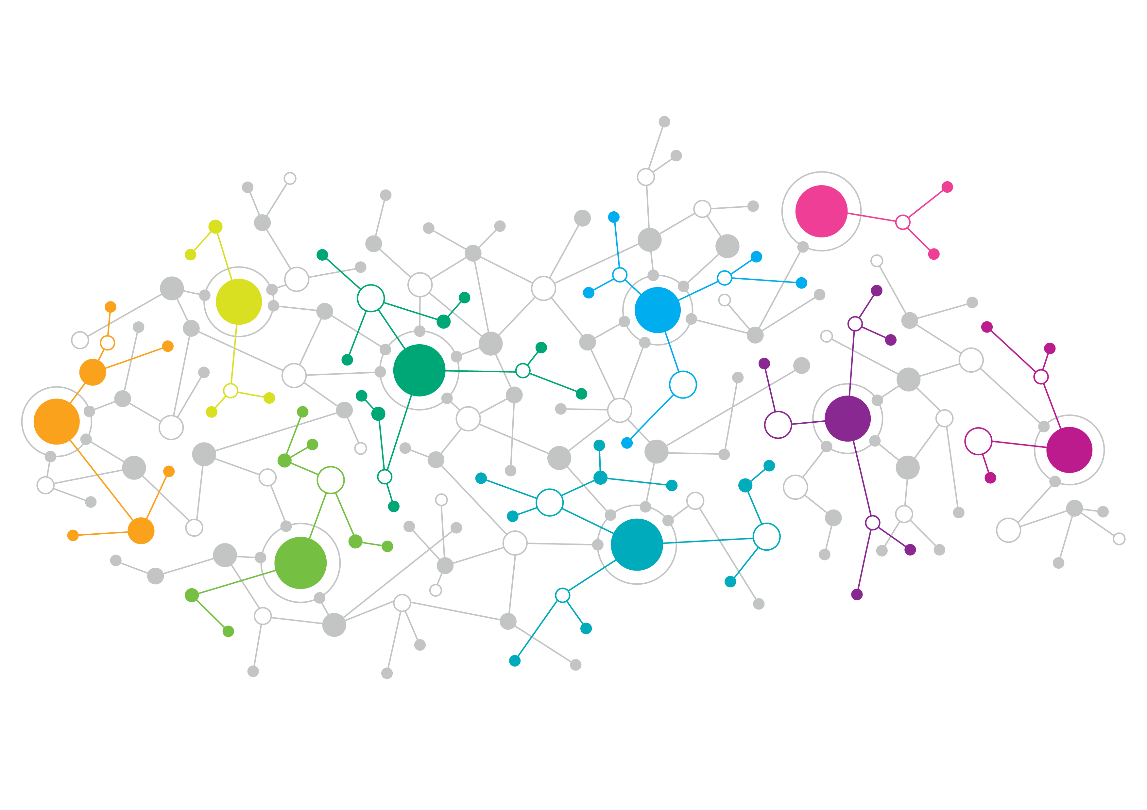



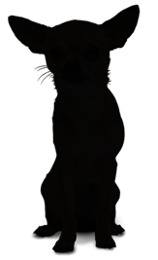
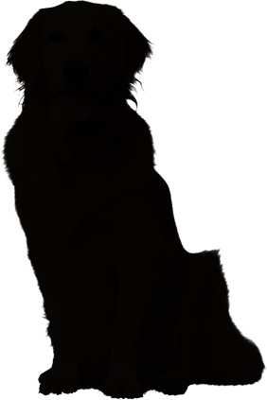
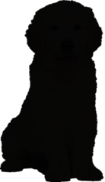
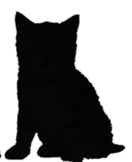




Python
Clean Code
Python
Environment
Object
Detection
Similarity &
Distance
Algorithms
TensorFlow Developer Certificate
Azure Fundamentals

Slide 2
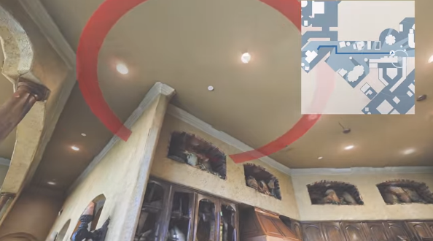





Python
Logging
Best Practices
Facebook Embodied Agent
http://gg.gg/lw5fr
Survival
Analysis
Python
Applications

Slide 3
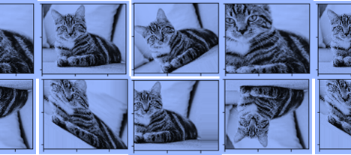



Data Augmentation
データ拡張
Feature Scaling
特徴量のスケーリング

Slide 4
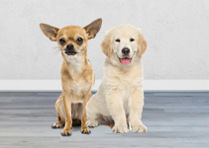
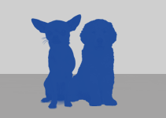




Object Detection
 | Result | Output Level | Instant Detect | All Areas Output | Models
Image Classification |  | Image | ✖ | 〇 | VGG ResNet Inception MobileNet DenseNet
Image Classification Localization |  | Box | ✖ | ✖ | HOG BOF PASCAL VOC
Object Detection |  | Box | 〇 | ✖ | R-CNN Fast R-CNN SDD YOLO RetinaNet
Semantic Segmentation |  | Pixel | ✖ | 〇 | U-NET MULTISCALE HYBRID CNN-CRF
Instant Segmentation |  | Pixel | 〇 | ✖ | Mask R-CNN DeepMask FCIS
Panoptic Segmentation |  | Pixel | 〇 | 〇 | Panoptic Feature Pyramid Network UPSNet
Dog 98%
Dog 93%
Dog 93%
Dog 97%
https://jingwora.github.io/

Slide 5



















PYSPARK
SKLEARN

Slide 6







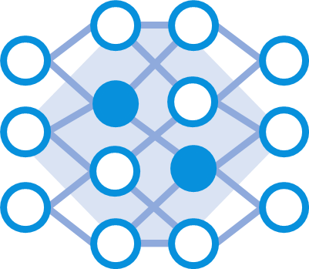
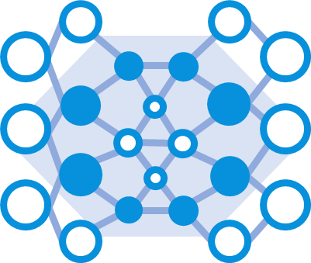
DATA PREPARATION
ARTIFICIAL
INTTELIGENCE
DATA CLEASING
WEB
SCRAPING
MACHINE
LAEARNING
MACHINE
LAEARNING
NEURAL
NETWORK
DEEP
LAEARNING

Slide 7

WWW

